Slide 1
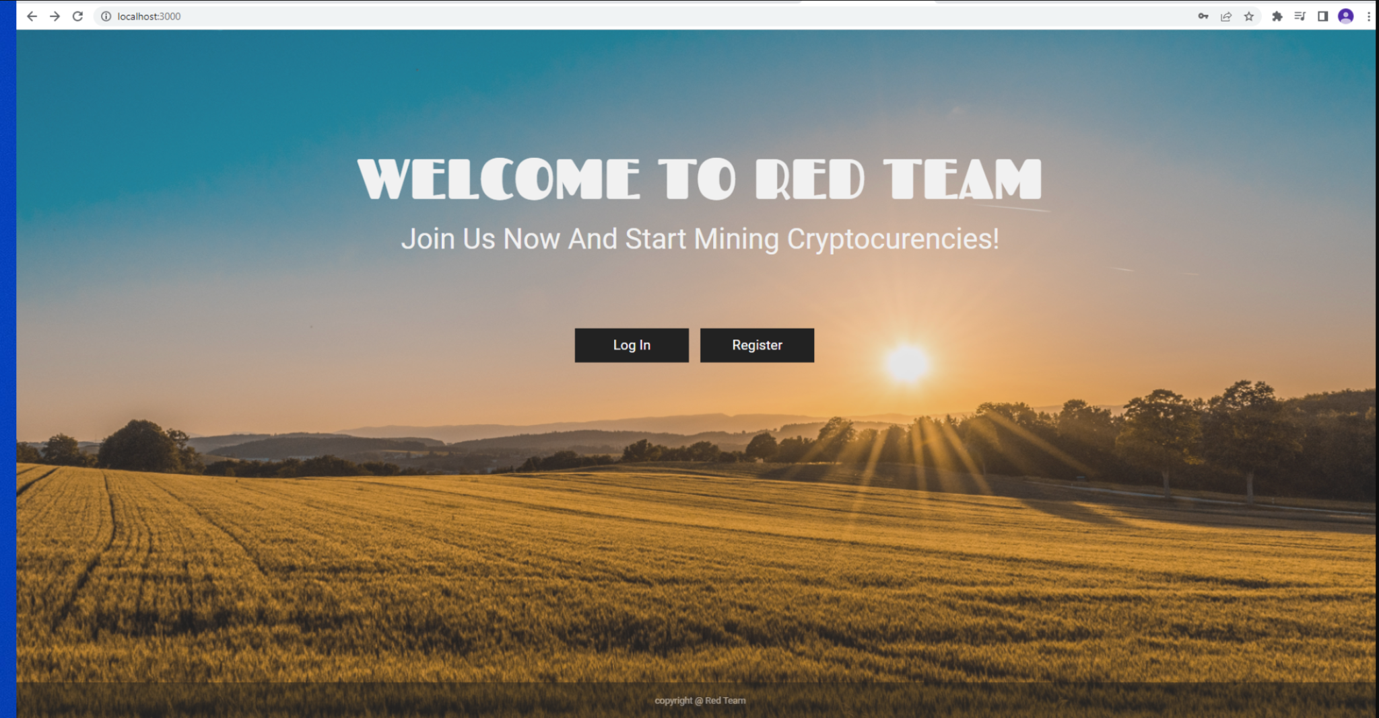


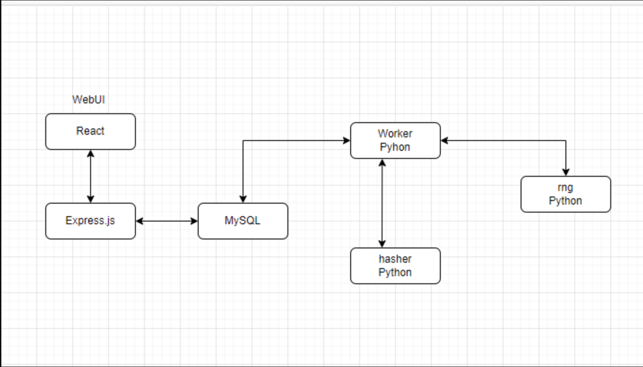


Red Team Coin Miner
By: Farah Bokhari, Troy Sivick, Girik Bangha, Eric Gaspar-Acuna, Khup Tuang
https://github.com/TS935609/CSC-468-Group
Challenges:
No experience with front-end coding
Communicating between different languages
Late change in project type
Connection between webui, database, and worker
Purpose:
Mine coins through an easy to use application
Multiple choices of coin
Provide starter page for either returning or new users
Activity will be logged into a database
Representation of data will be displayed by portfolio
Real-time updates provided through the cloud
Design
React for front-end design
MySQL for database
Express.JS for back-end program
Hasher, worker, & RNG deployment via
Python
Worker communicates with both hasher and rng and then sends data to the database
Database communicates with webui and worker and stores important user data in the portfolio
Deploy Kubernetes using Docker for cloud real time updates

